Slide 1
3D MMWave for Gesture Recognition
Presenter: Hao-Hsuan Ting 丁浩軒
Tel: 0972-332008
E-mail: r12944052@ntu.edu.tw
Advisor: Prof. Chiou-Shann Fuh 傅楸善

Slide 2
Outline
Introduction
Methodology
Conclusion

Slide 3
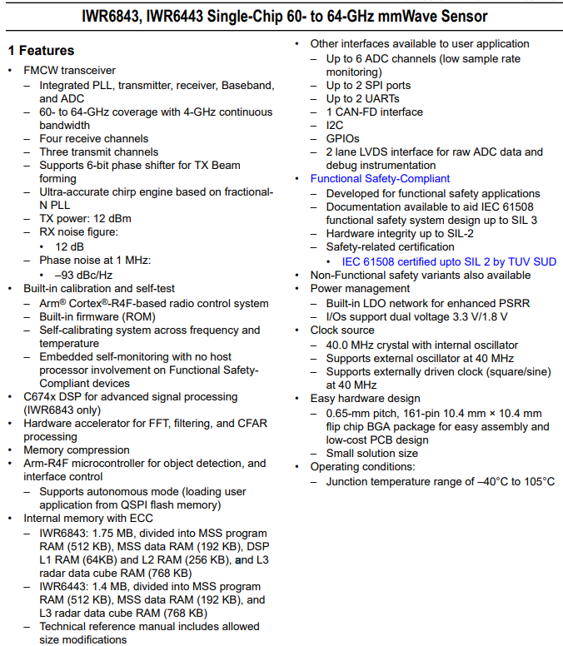
Introduction
Texas Instrument IWR6843 MMWave sensor
Industrial sensors for measuring range, speed, and angle
Gesture recognition
Position sensing
People counting
Motion detection

Slide 4
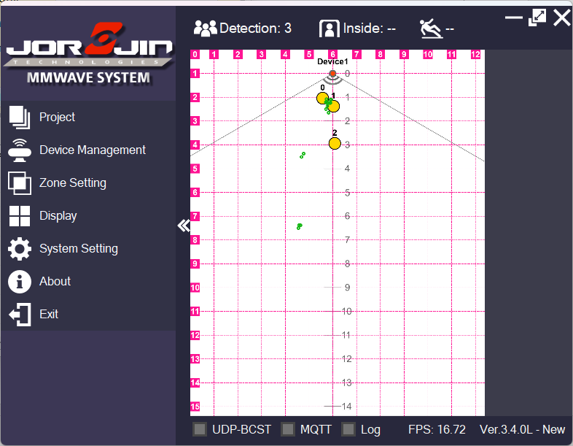
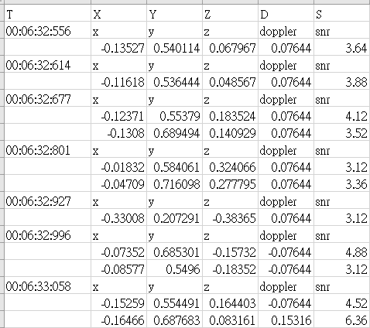
Introduction
People counting
Spatial position and speed

Slide 5
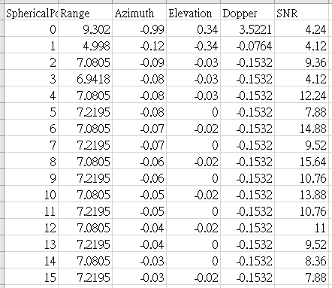
Introduction
Raw output data is represented in polar coordinates.
The angular resolution is 0.01 radians
Both Elevation and Azimuth

Slide 6
Introduction
MMWave Resolution
Elevation ranges from -0.34 to 0.34 radian (-19.48° to 19.48°)
The missing angles include -0.32, ±0.25, ±0.23, ±0.18, ±0.16, ±0.13, ±0.11, ±0.04, and ±0.01 radian
Azimuth ranges from -1.28 to 1.27 radian (-73.338° to 72.766°)
No missing angle

Slide 7
Introduction
MMWave Resolution
We can use elevation and azimuth to generate a 69 pixels * 256 pixels image
This image is generated by accumulating point cloud, not real-time point cloud
Notes:
越近越紅

Slide 8
Methodology
2D Heat map De-noising
Histogram

Slide 9
Methodology
2D Heat map De-noising
There are many noises points in output data
Closing operation
Opening operation
Median Blur
Gaussian Blur

Slide 10
2D Heat map De-noising
2D Heat map De-noising
Keep two images: one is binary image, other is gray-level image
Binary image: pixel = 255 if there is any point in this pixel
Gray-level image: pixel = 255 * (range_of_point - 0.5) / (3-0.5)

Slide 11
2D Heat map De-noising
2D Heat map De-noising
Keep two images: one is binary image, other is gray-level image
Binary image: pixel = 255 if there is any point in this pixel
Gray-level image: pixel = 255 * (range_of_point - 0.5) / (3-0.5)
Do Dilation first and then do Erosion to complement the lack of pixel
Manipulate two images separately

Slide 12
2D Heat map De-noising
Opening operation
Do dilation twice and then do erosion twice
Kernel (3 by 3) is too big for image, so do these twice
Do opening operation on two images separately
After opening
If pixel = 0 in binary image, set pixel = 0 in gray-level image
Else pixel in gray-level image does not change

Slide 13
2D Heat map De-noising
Median Blur – Method 1
The median blur effect is similar to the erosion effect
Do dilation and then do erosion
Do median blur on gray-level image three times
Why do it three times? The best de-noising effect
Finer, more detail => better than opening

Slide 14
2D Heat map De-noising
Median Blur – Method 2
The median blur effect is similar to the erosion effect
Do dilation and then do erosion
Do median blur on binary image three times for de-noise
Do median blur on gray-level image one time for pixel value expansion
After blurring
If pixel = 0 in binary image, set pixel = 0 in gray-level image
Else pixel in gray-level image does not change

Slide 15
2D Heat map De-noising
Median and Gaussian Blur – Method 3
The median blur effect is similar to the erosion effect
Do dilation and then do erosion
Do median blur on binary image three times for de-noise
Do Gaussian blur on gray-level image one time for pixel value expansion
After blurring
If pixel = 0 in binary image, set pixel = 0 in gray-level image
Else pixel in gray-level image does not change

Slide 16
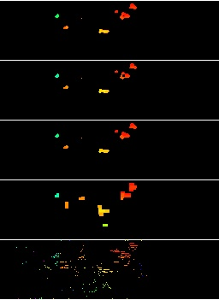
2D Heat map De-noising
Comparison
Image from top to bottom respectively is
Method 3: Gaussian blur
Method 2: median blur
Method 1: 3 times of median blur
Opening
Raw image
Notes:
9-30
提到第二張中間空缺沒有被填滿

Slide 17
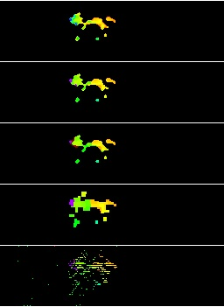
2D Heat map De-noising
Comparison
Image from top to bottom respectively is
Method 3: Gaussian blur
Method 2: median blur
Method 1: 3 times of median blur
Opening
Raw image
Notes:
182
提到第三張有黑色pixel

Slide 18
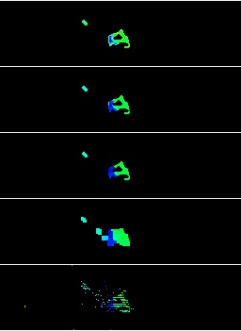
2D Heat map De-noising
Comparison
Image from top to bottom respectively is
Method 3: Gaussian blur
Method 2: median blur
Method 1: 3 times of median blur
Opening
Raw image
Notes:
314

Slide 19
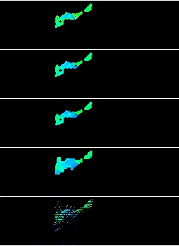
2D Heat map De-noising
Comparison
Image from top to bottom respectively is
Method 3: Gaussian blur
Method 2: median blur
Method 1: 3 times of median blur
Opening
Raw image
Notes:
555
一樣，空缺並沒有填滿太多

Slide 20
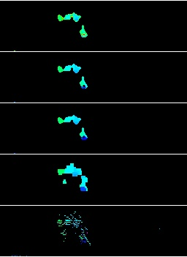
2D Heat map De-noising
Comparison
Image from top to bottom respectively is
Method 3: Gaussian blur
Method 2: median blur
Method 1: 3 times of median blur
Opening
Raw image
Notes:
677
顏色沒有擴散太多

Slide 21
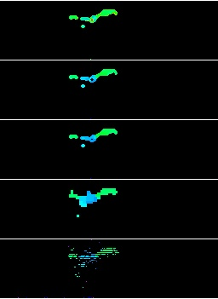
2D Heat map De-noising
Comparison
Image from top to bottom respectively is
Method 3: Gaussian blur
Method 2: median blur
Method 1: 3 times of median blur
Opening
Raw image
Notes:
694
空缺

Slide 22
2D Heat map De-noising
Comparison
Method 3: Gaussian blur
The blurred pixel value is not good
Method 2: median blur once
I think this is the best one and quicker
Method 1: 3 times of median blur
Also great, but the detail is worse than one-time method and slower
Opening operation
No detail

Slide 23
Histogram
Calculate histogram on gray-level image
Pick up the point in range
[minimum non-zero pixel value: minimum non-zero pixel value +15]
At beginning, we set the point range within range: 250 cm = 300 – 50 cm
250 cm almost can map onto 256 pixels
15 pixel value equals to 14.6 cm, one hand size
15 cm: hand at the shortest distance, 15 cm to remove body and other points as noise
Can detect one hand in mmwave sensor range
Can detect more than one hand, but must wave at the same distance

Slide 24
Conclusion
Method
Enhance the clarity of hand-waving motion in 2D heat map by image processing method.
Step
Convert mmwave output data to 2D heat map
Use opening and closing and median blur to de-noise the heat map
Highlight hand information using histogram.
Result
Can detect one hand in mmwave sensor range.

